Slide 1
here we are!
“Riccardo Monterisi” Secondary School - Bisceglie - Italy

Slide 2
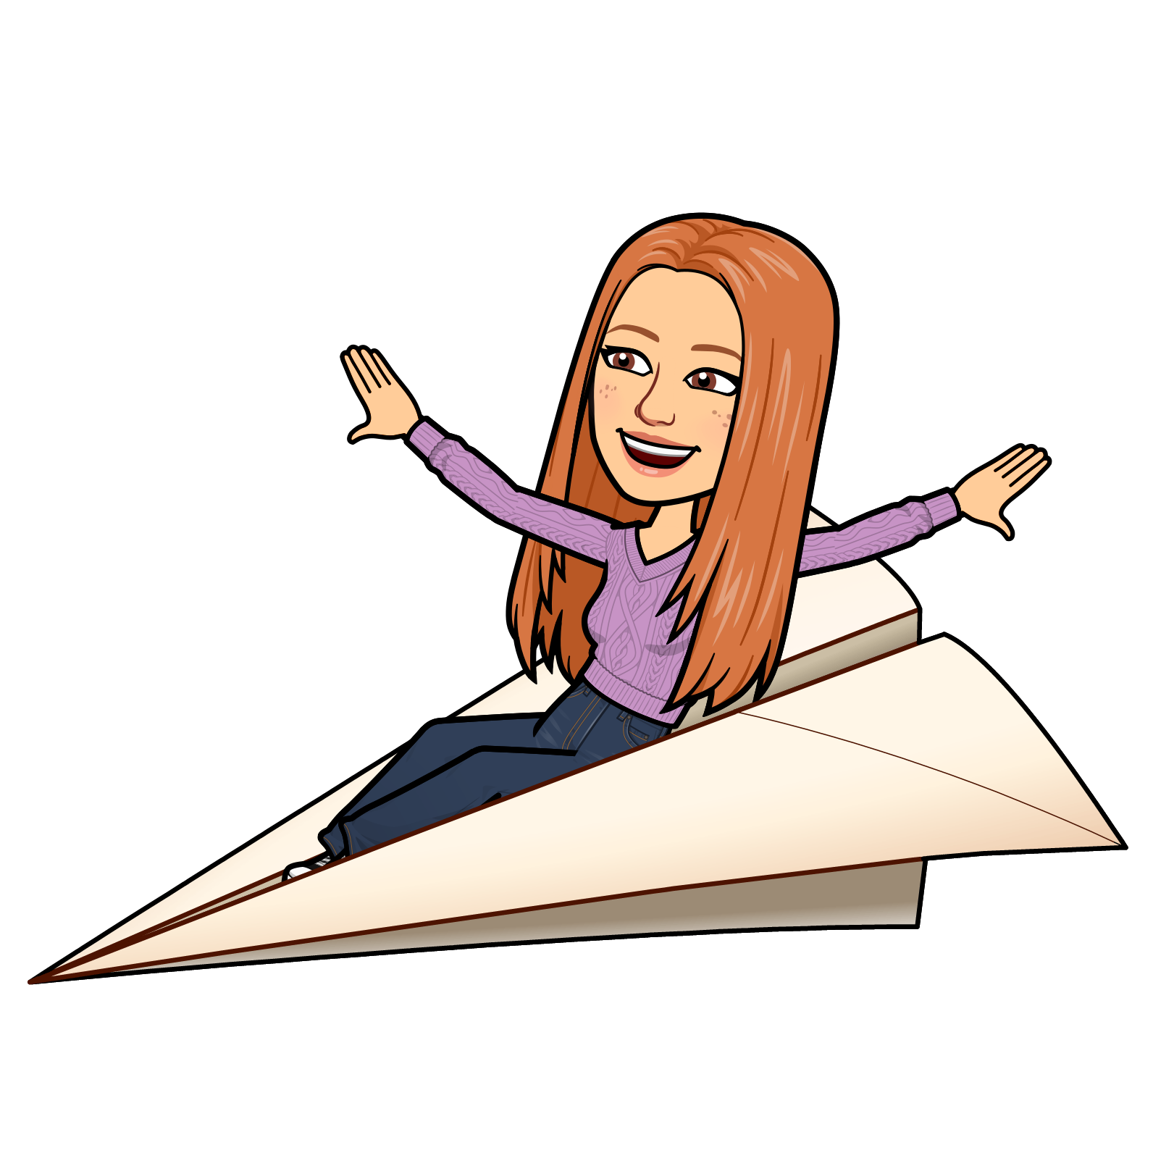
caprioli stefania rita
I love sweatshirts and jeans for Winter. My favourite season is Summer because I love sea. My best friend is Arianna. She plays the clarinet in the school orchestra. In my family we are four: my father Michele, my mother Enza, my little sister Claudia and me. My family is welcoming. I love it.
Hello everyone. I am Stefania. I am 13 years old and I was born on May 22nd. I live in Bisceglie and I attend the eighth grade. I’m a student at Monterisi school. My favourite subjects are French and Maths. I don’t like Science and History. I am thin; I have brown hair and brown eyes. I am kind, cautious and sometimes stubborn. During my free time I practice athletics because I love running. I like sports. My favourite food is pizza and carbonara (pasta with bacon and eggs).

Slide 3
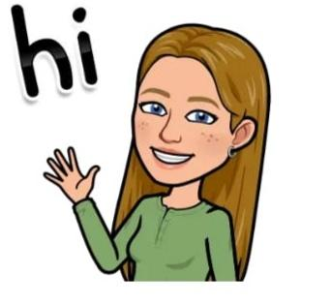
frisari alessandra
Hello everyone, I’m Alessandra, I’m 13 and I was born on August 19th. I'm from Italy and I live in Bisceglie. I'm a student at Monterisi School in Bisceglie. My favourite subjects are English and Science. The subject I don’t like is Geography because I think there are too many names to remember. In my spare time I like hanging out with my friends, spending time outdoors and going out for long walks. I also like listening to music but I don’t have a favourite music style, I often listen to the songs I like. I love spending my time watching films/TV series and going shopping.
One of my hobbies Is cooking. Actually, sometimes I help my mum to cook, especially sweets, that I love. I am about 1.60 m. tall, I have long blond hair and blue eyes, I’m very similar to the avatar. I’m a quite friendly person but at first I’m a little bit shy.

Slide 4

lamanuzzi giuseppe
Hello, my name is Giuseppe and I’m from Italy. I live in Bisceglie, I’m fourteen and I am in the third year of middle school that is called “Scuola Media Riccardo Monterisi”. I’m good at all subjects but, my favourite is History. In my family we are four: my father, my mother, my little sister and me. In my free time I do a lot of things like playing video games, helping my sister with the homework, helping my mom doing the household chores and sometimes on Sunday morning I go with my dad to buy food. On Saturday afternoons I go to the church.
My favourite colors are green and blue. Sometimes I also listen to music in fact my favourite types of music are rock, pop and computer music. I’m friendly and talkative.

Slide 5
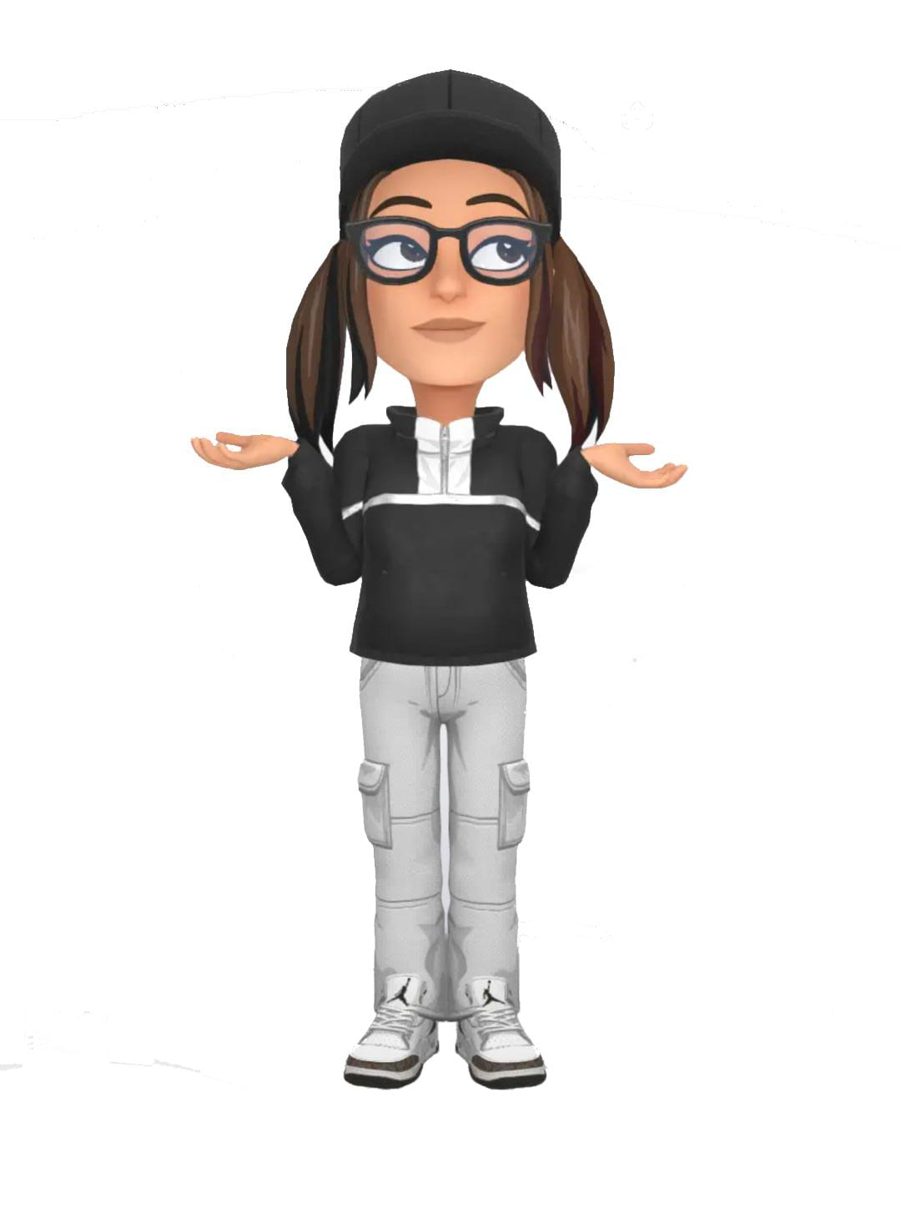
lampedecchia sofia
I'm about 1.60 m. tall. I have long brown hair, which I will cut soon. I have almond shaped brown eyes and I wear black glasses. I don't have a style, I get dressed according to how I feel. I am a punctual person, sometimes generous and emotional. I'm arrogant with my brother, but only because he often makes me angry. I only go out during the weekend because as I said, I dance all week. I put a lot of effort into studying and being able to do everything is a great achievement for me.
Hello everyone, my name is Sofia, I'm 13 and I was born on April 15th. I started school a year early, so I should do the second year of scuola media, but I'm going to do the third. I practice a lot of sports, in fact I go to dance every day. My favorite subject is English, while the one I don't understand well is History. My best friend is called Angelica and I am very fond of her, she is in my class!

Slide 6
pisani lorenzo
My name is Lorenzo. I'm 14 years old. I was born on the 26th of February. I live in Bisceglie. I am a student of the Monterisi school. My favourite subject is Science. The subjects that I don't like are Maths and Technology. I'm 1.62m tall. I have dark black hair. My favorite sport is football . My favorite food is pizza and lasagna. My favorite season is winter, to celebrate Christmas (my favourite holiday) and my birthday.
My favourite colour is black. I don't have any pets. I always play video games ( it is my favorite hobby ) .
I like listening to music and my favourite genre is pop from the 80s and 90s. We are 4 in my family : my sister , me , my mother and my father. We are a very close family and we love each other.

Slide 7
Todisco nicola
summer school finishes and in winter there is snow which I love.My favourite colors are red and blue.I also have a dog called “Russell” that I got as a gift at Christmas.I like playing video games and play with my friends.I also play football every Tuesday and Thursday and I really enjoy it.In my family we are 5:my Dad,my Mom my,my two sisters and of course me.
HI my name is Nicola.I’m 13 years old.I was born on 11th of December 2009.I live in Bisceglie and I’m a student of the Monterisi school where I meet lots of good teachers. Overall my favourite subject is Science,English and also Technology but I don’t like at all Italian which I hate a lot.I’ve got blonde hair and brown eyes. My favourite food is spaghetti…I love them I would eat them everyday if my mum allowed me to.My favourite seasons are summer and winter because in

Slide 8



MRS LIUZZI
Hi everyone, I'm Mara Liuzzi and I teach Maths and Science. I really like cooking and eating well, travelling and visiting art cities, walking in nature and playing sports, especially volleyball that is my favourite. My family consists of my husband, two daughters and one dog, a French bulldog called Chico.

Slide 9
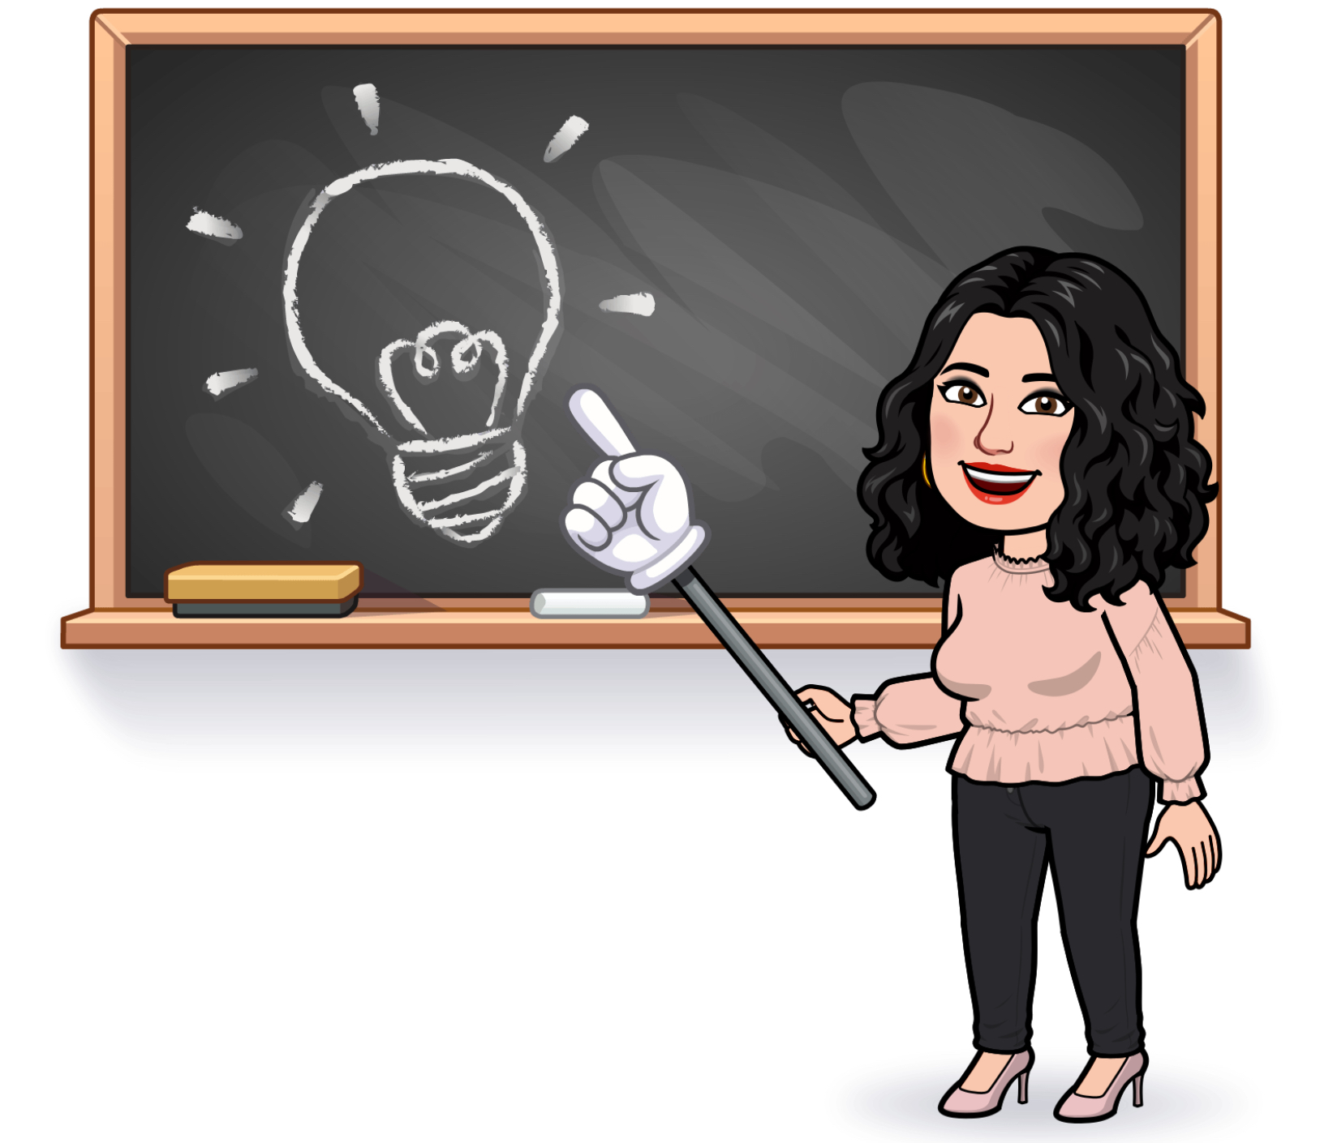

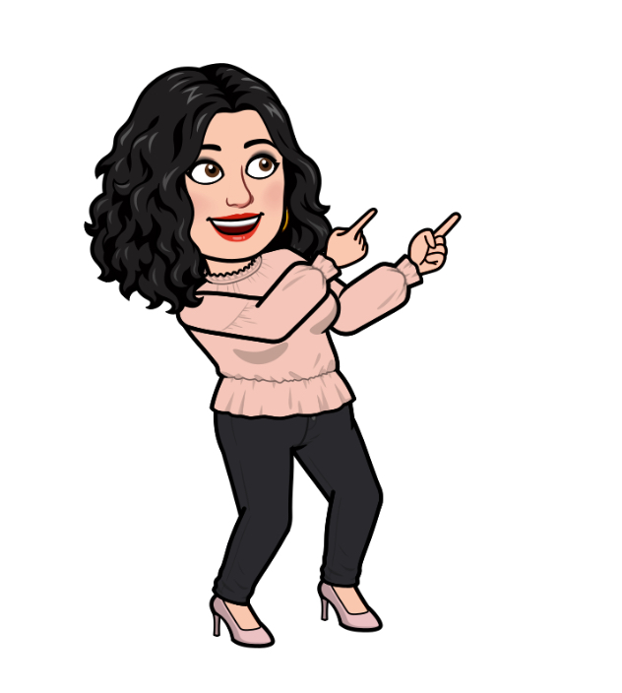
Mrs Messina
Bonjour à tout le monde!
My name is Anna Maria Messina and I’m a French teacher.
I think my job is the best in the world, because I love being with my students, listening to them, understanding their needs and helping them recognize their strengths and weaknesses and develop their skills.
I love reading, watching films, travelling, listening to music, practicing pilates and swimming.
I usually spend my free time with my family (my husband and my three children) and my friends.

